Slide 1

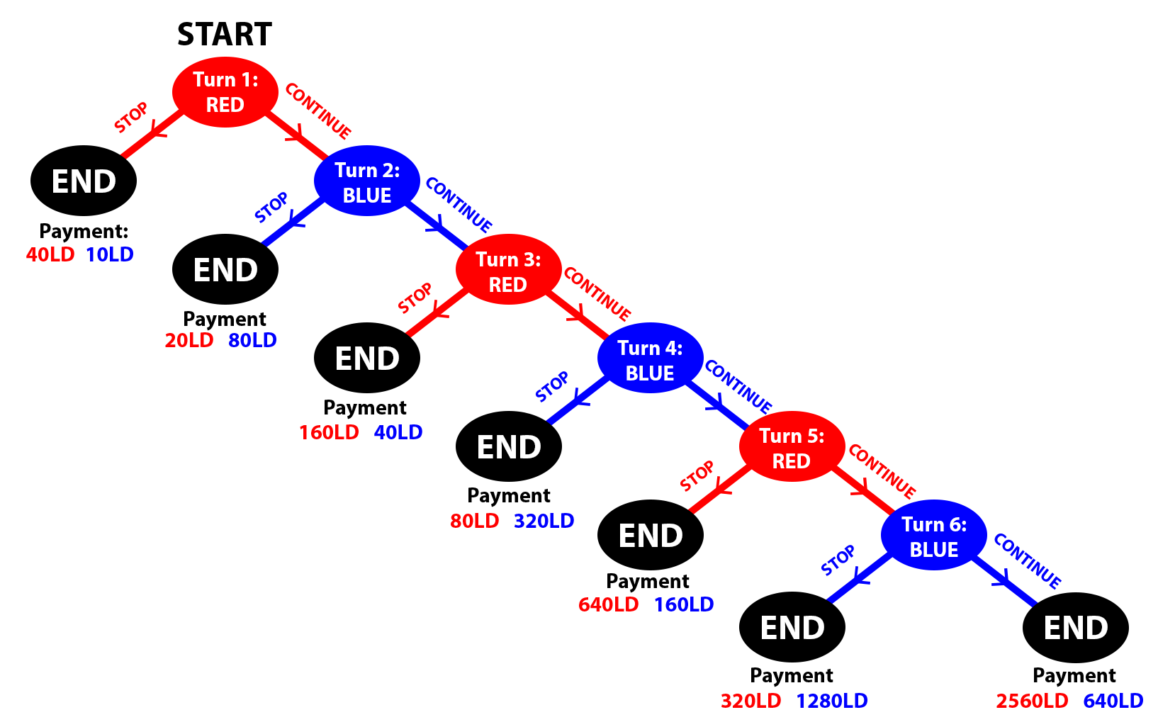

Natural Language Processing on Mission Statements of Tax-Exempt Organizations
Hariaksha Gunda
Advisor: Dr. Michael Price
Department of Economics, Finance, and Legal Studies
ABSTRACT
METHODOLOGY
MOTIVE ELICITATION
This research project provides a better understanding of the impact of mission statements of tax-exempt organizations on fundraising, specifically in the United States, Australia, the United Kingdom, and Canada. We utilize the Python Requests and BeautifulSoup libraries to web scrape mission statements, names, revenue, and other relevant data from the IRS, GuideStar, and Charity Navigator. After generating the data, we use techniques drawing from Natural Language Processing (NLP) and statistics to identify patterns in mission statements across different categories of tax-exempt organizations like religious charities and medical nonprofits. NLP libraries used include Natural Language Toolkit (NLTK), Regular Expressions (RegEx), and SpaCy. In full, this project provides insight into the impact of mission statement language on fundraising efforts. All project code, data, and documentation can be found at github.com/Hariaksha/NLP-Charity-Research.
Frequently studied example of people breaking from subgame perfection. Perfect example of the paradoxical nature of backwards induction and rationality:
At turn 6, BLUE’s best choice is to STOP
This means at turn 5, RED’s best choice is to STOP
...Continues this logic to turn 1…
RED’s best choice is to stop turn 1
The subgame perfect equilibrium (which assumes sequential rationality) is ending turn 1.
Humans do not behave this way and receive on average more money because of it (deviation is a Pareto improvement over equilibrium). The game highlights the paradoxical nature of rationality since higher intelligence individuals deviate more from rational behavior and received more money from this “irrational” behavior. *cite*
Eliciting individual's true motivations is a significant challenge in game theory research as isolating individual motivations and traits is difficult from a single experiment. Our research takes several approaches to elicit participant’s true motivations:
Using 2 variant centipede game conditions to control for and isolate several contributing motivations
Incorporating a qualitative aspect by directly asking participants their thought processes instead of only extrapolating from quantitative results.
HYPOTHESES
Figure 1: Centipede Game
Mission statement language will affect revenue of tax-exempt organizations.
Mission statements with language identifying as more donor-serving will correlate with higher revenue.
The effects of mission statement language on revenue will be less powerful for tax-exempt organizations with higher asset codes.
The effects of mission statement language on revenue will differ slightly among categories of tax-exempt organizations, such as education versus health nonprofit.
“If this is rationality, they want none of it” – Robert Aumann²
BACKGROUND
RESULTS
Natural Language Processing:
Natural Language Processing (NLP) is the branch of Artificial Intelligence that enables computers to understand, manipulate, and generate human language.
This technology is vital for many applications involving unstructured and textual data.
Nonprofits in America:
Most nonprofits are small and community-based, and 92% operate with less than $1 million a year.
There are 1,859,826 tax-exempt organizations in the country.
Language and Impact:
Prior research indicates that mission statement language correlates with economic and organizational performance.
RESEARCH QUESTION
How does a participant’s perception of their opponent’s IQ affect their own choices?
TIDE (The Interactive Decision Experiment) Lab
Undergraduates recruited with monetary incentive
Interact anonymously on computers using z-Tree software
Told their opponent’s IQ
4th quartile
3rd quartile
FUTURE STEPS
Participant Pool
Not told their opponent’s IQ
2nd quartile
The next steps are:
Generate data from the United Kingdom, Australia, and Canada
Create computational linguistic measurement of "self VS other" language and assign respective value to each mission statement.
Analyze the data and note important patterns.
Train ML model on training data to estimate revenue of tax-exempt organization given mission statement and asset code.
Test ML on testing data.
1st quartile
Figure 2: Experimental groups
Raven’s IQ Test
Centipede Games
Qualitative Questions
Reasoning/ Attitude
MOTIVATION
The nonprofit sector largely consists of small, community-based organizations working with meager resources. For this reason, nonprofits rely on resources and research to operate more effectively. Prior researchers have begun to understand the impact of different linguistic structures and patterns on economic and organizational performance. This project furthers these efforts by addressing a research gap surrounding empathy and compassion in mission statements. We evaluate the impact of "self VS other" linguistic structures on revenues of tax-exempt organizations. This research will provide a better understanding of the impact of linguistic features and can be applied to increase charitable donations and elevate the impact of a wide array of nonprofits, thereby touching the lives of countless individuals.
Raven’s test is a standard metric for IQ that consists of a set of matching puzzles
Participants will not be told it is a metric for IQ until afterwards.
They will not be told their own results.
3 different variants of the centipede game will be played in a randomized order:
Standard exponential increasing pot
Linearly increasing pot
Constant sum pot
Randomly paired with different opponent for each game. One group will be told IQ quartile of their opponent.
Survey questions about thought process and reasoning the participant’s used in each of the games.
Examples:
Please describe the decision-making process you used in Game 1?
Did learning the IQ of the other participant effect the way you approached your strategy?
Reasoning test to baseline the participants ability to reason through a backward induction problem.
Short social attitudes test to measure other-regarding preferences
Demographic data is automatically collected by TIDE Lab
REFERENCES
[1] Yaden, D. B., Giorgi, S., Jordan, M., Buffone, A., Eichstaedt, J. C., Schwartz, H. A., Ungar, L., & Bloom, P. (2024). Characterizing empathy and compassion using computational linguistic analysis. Emotion, 24(1), 106–115. https://doi-org.libdata.lib.ua.edu/10.1037/emo0001205.supp (Supplemental)
[2] Baek, Y. M., Ihm, J., & Kang, C. H. (2023). Does mission concreteness make a difference in nonprofit performance? Automated text analysis approach to the importance of concrete mission statements. Nonprofit Management & Leadership, 34(2), 409–431. https://doi-org.libdata.lib.ua.edu/10.1002/nml.21570
[3] Ward, B. (2023). Relationship Between Mission Statement Components and ROA: A Study of Small-Cap Financial Firms. IUP Journal of Business Strategy, 20(4), 5–19.

